Slide 1


Nutrition Workshop
www.communitykitchens.org.au
Notes:
Hello everyone. My name is Sue Harman and I am a Health promotion Officer at Barwon Health Geelong and Coordinator of Community Kitchens in the Barwon region.
This presentation will cover the nutrition information you will require as a facilitator of Ck’s or if you are interested in this topic.

Slide 2
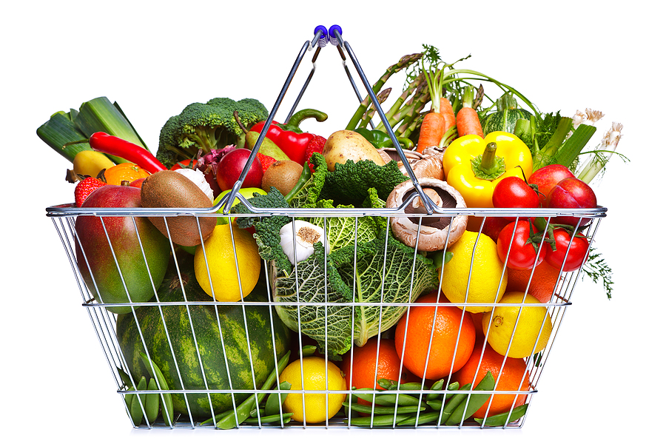
Overview of the Session
Importance of food
Food groups
Modifying a recipe
What a meal should look like
Notes:
Today we are going to talk about nutrition in CK
The main things were going to cover is
The importance of food for our bodies
The different types of food groups and how much to eat
How to change a recipe to make it better for us
And what a typical meal should look like
References:
http://www.charterfitness.com/wp-content/uploads/2013/03/bigstock-Shopping-Basket-Fruit-And-Vege-13789097.jpg

Slide 3

What Makes Us Choose The Foods We Eat?
Cost
Health
Social occasions
Enjoyment
Celebration
Religious significance
Habit
Food knowledge
Taste
Memories
Notes:
We all choose foods for lots of different reasons.
What are some of the reasons we choose certain foods?
Cost
Health
Social occasions
Enjoyment
Celebration
Religious significance
Habit
Food knowledge
Taste
Memories
http://nextstepu.files.wordpress.com/2013/04/confused.jpg

Slide 4
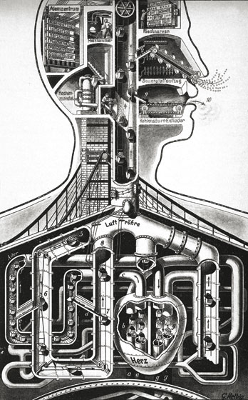
Why do we need food?
Food is fuel for our bodies
It gives us the energy we need for our bodies work
We use food to:
  Breathe
  Make our heart beat
  Think
  Grow
  Repair
  Replace
Notes:
Our body is a little bit like a machine and food is the fuel that makes it work
We need food to be able to
Breathe
Make our heart beat
Make our muscle work
Help our brain to think
http://www.topdesignmag.com/wp-content/uploads/2011/02/3181.jpg

Slide 5
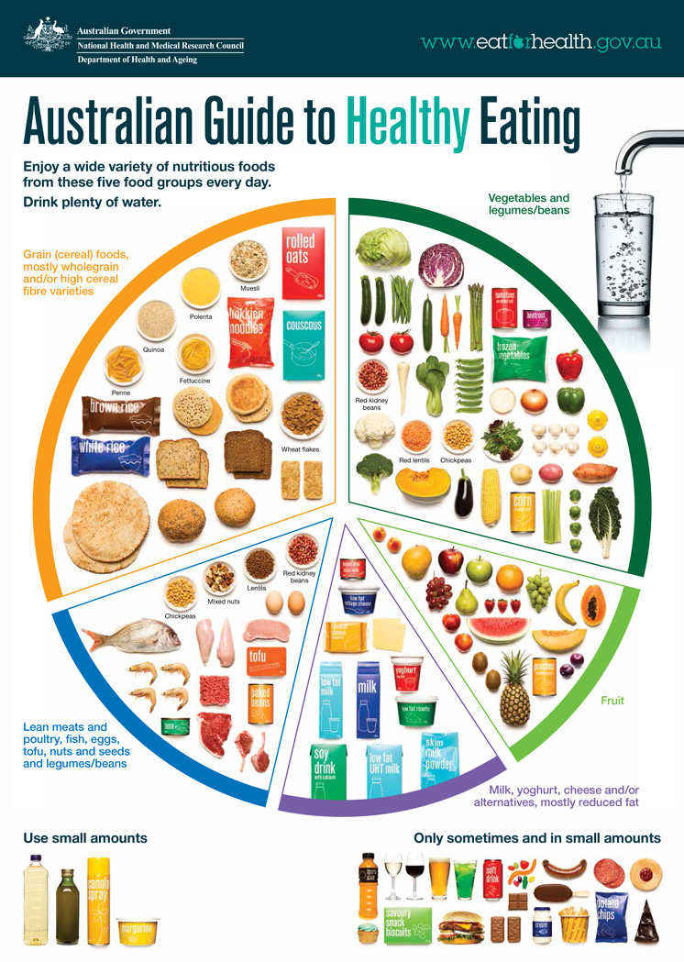
Australian Dietary
Guidelines
5 Core Food Groups
Grains (cereals)
Vegetable and legumes
Fruit
Dairy and alternatives
Meat, fish, poultry and alternatives
Notes:
In Australia we have a set of guidelines that we follow for healthy eating.
Has anyone heard of the new Australian Dietary Guidelines
Its broken up into 5 food groups
Enjoy a wide variety of nutritious foods from these five groups every day:
Plenty of vegetables, including different types and colours, and legumes/beans
Fruit
Grain (cereal) foods, mostly wholegrain and/or high cereal fibre varieties, such as breads, cereals, rice, pasta, noodles, polenta, couscous, oats, quinoa and barley
Lean meats and poultry, fish, eggs, tofu, nuts and seeds, and legumes/beans
Milk, yoghurt, cheese and/or their alternatives, mostly reduced fat (reduced fat milks are not suitable for children under the age of 2 years)
And drink plenty of water.

Slide 6
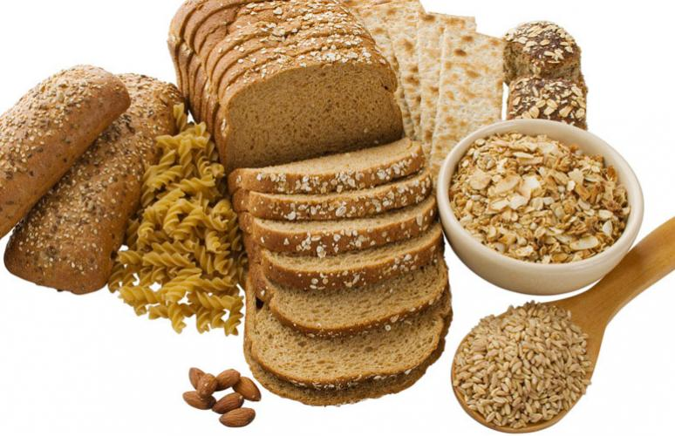
Grains (Breads and Cereals)
Good source of carbohydrates
Important source of
  ENERGY
  Vitamins
  Fibre (helps us feel fuller for longer)
  Choose GRAINY options (brown, wholemeal, multigrain)
Rice, pasta, bread, breakfast cereal, couscous, polenta, lentils and legumes
Notes:
The first core food group we have is grains
Carbohydrates are really important because they
Are our main source of energy
Contain vital vitamins
We want to choose GRAINY options like brown, wholemeal, multigrain
these give us fibre
What are some examples?
Choose grainy option- brown rice, wholemeal pasta, multigrain bread
http://www.berkeleywellness.com/sites/default/files/Food-wholewheat-Masterfile2011.jpg

Slide 7
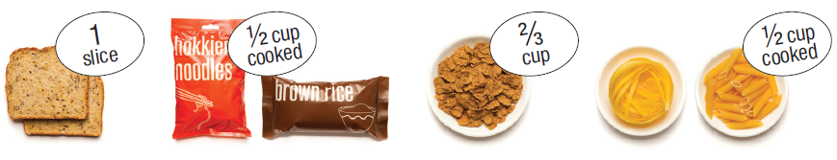
Recommendations:
Grains (Breads & Cereals)
Serves per day
 | 19-50 years | 51-70 years | 70+ years
Men | 6 | 6 | 4 ½
Women | 6 | 4 | 3
1 serve is:
Notes:
This is how much we should have of the grains group
One the left you have your gender (male and female)
With your age group across the top
So for example I am female and aged between 19-50 years old so I nee 6 serves
Any questions?
Ok I know I need 6 serves a day
But what is a serve?
1 slice of bread is 1 serve
½ cup of rice is 1 serve
2/3 cup cereal is 1 serve
½ cup of pasta is 1 serve
½ cup of cooked porridge is 1 serve
For example for someone aged 19-50
1 cup of cooked porridge for breakfast is 2 serves
A sandwich with 2 pieces of bread at lunch is 2 serves
1 cup of rice or pasta at dinner which is 2 serves
Will meet you needs for grains for the day
If you fit into a different age group this might be too much for you.

Slide 8
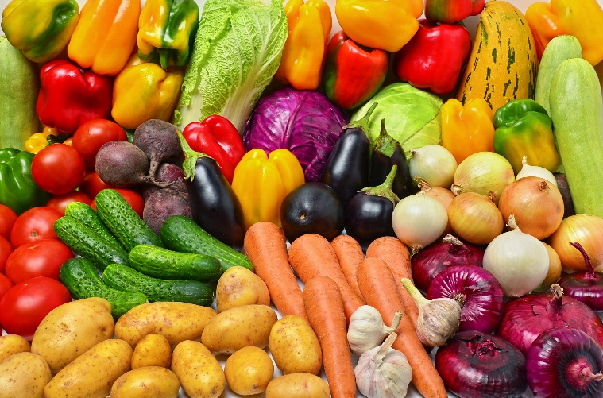
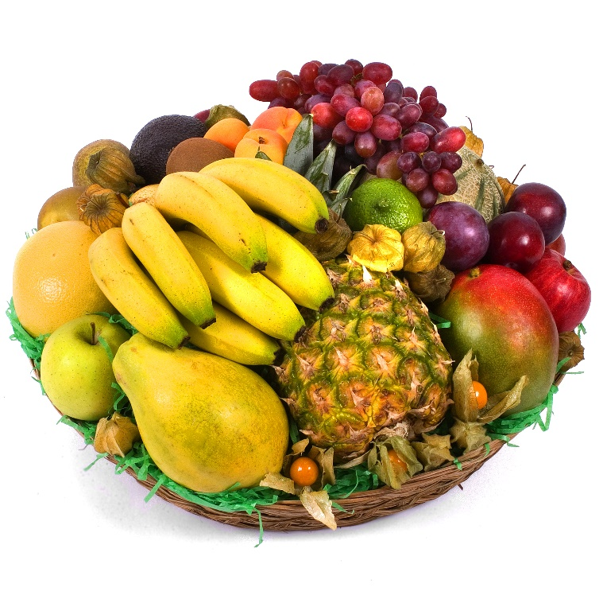
Fruits and Vegetables
Provide fibre
  Healthy bowel
  Help to lower cholesterol
The more colours you eat the more types of vitamins and minerals you get!
Notes:
Next we have fruit and vegetables
Why are fruits and vegetables important for us?
Fibre
Vitamins
Minerals
Different coloured f/v have different vitamins and minerals, so we need to try and have a variety.
http://cdn.fansided.com/wp-content/blogs.dir/306/files/2014/07/Depositphotos_650
0963_XL.jpg
http://www.gajanayakafruits.com/images/baskets/Fruit-basket.jpg
Name some fruits and vegetable

Slide 9
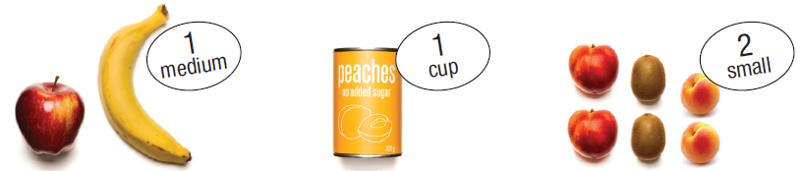
Recommendations:
Fruits
Serves per day
 | 19-50 years | 51-70 years | 70+ years
Men | 2 | 2 | 2
Women | 2 | 2 | 2
1 serve is:
Notes:
It doesn’t matter what age adults should aim to have 2 serves of fruit a day.
1 medium fruit, 1 cup of tinned fruit (in natural juices) and 2 small pieces of fruit are 1 serve.
What is an example of 2 serves of fruit?

Slide 10
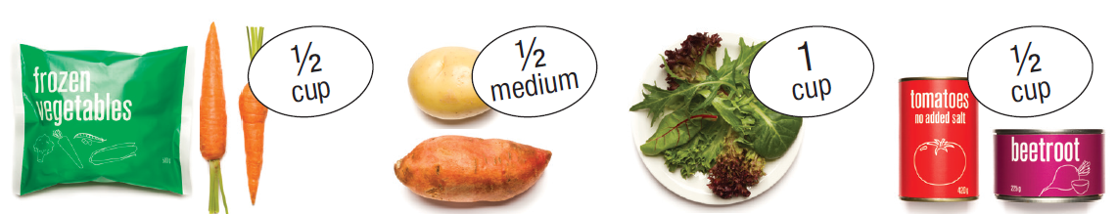
Recommendations:
Vegetables
Serves per day
 | 19-50 years | 51-70 years | 70+ years
Men | 6 | 5 ½ | 5
Women | 5 | 5 | 5
1 serve is:
Notes:
We want to have lots of vegetables in a day. We are looking between 5 and 6 serves per day depending on what category we fall into.
1 serve of vegetables is ½ a cup of carrots/broccoli/peas/beans. Sometimes thinking of alternatives can help with budgeting for example buying frozen or tinned vegetables.
½ a medium potato is also 1 serve as well as 1 cup of salad vegetable (lettuce, spinach).

Slide 11
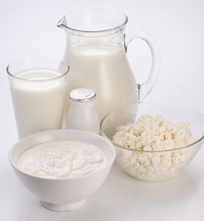
Dairy and Alternatives
Milk, yoghurt, cheese, custard or calcium-fortified soy alternatives.
Full of protein and calcium
Help repair and make healthy bones and teeth
Choose low fat versions
Notes:
The next core food group is dairy and alternatives. Does anyone know why we have dairy foods?
Dairy foods provide us with protein and calcium to help make our bones strong. When choosing dairy foods we should choose ones that are low in fat.

Slide 12
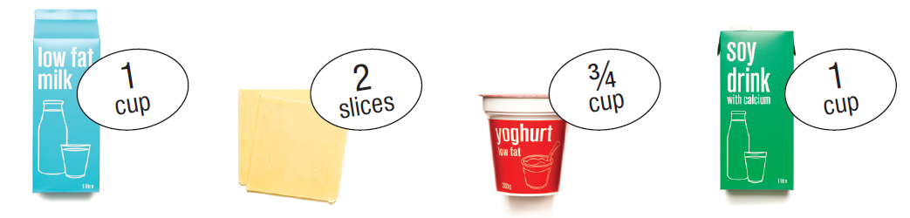
Recommendations:
Milk, yoghurt, cheese
Serves per day
 | 19-50 years | 51-70 years | 70+ years
Men | 2 ½ | 2 ½ | 3 ½
Women | 2 ½ | 4 | 4
1 serve is:
Notes:
Some examples of dairy foods include low fat dairy, low fat cheese and low fat yoghurt.
Again there is a daily recommended amount of serves.
1 serve of dairy is:
1 cup of milk
2 slices of cheese about the size of a matchbox
¾ of a cup of yoghurt.
Does anyone have any questions?
Alternatives if asked:
Calcium fortified milks such as soy milk, salmon with bones, almonds.

Slide 13
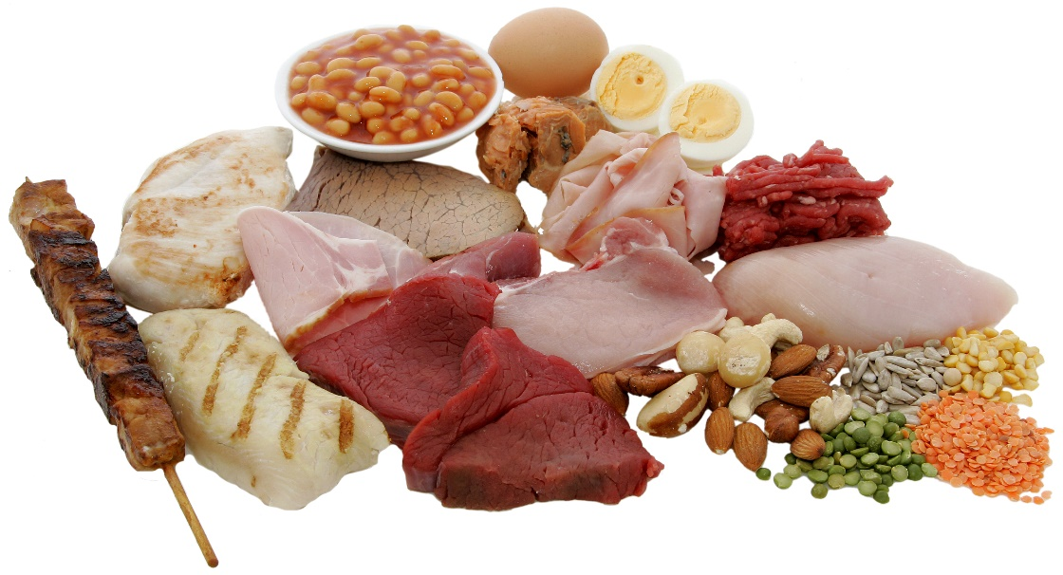
Meat and Alternatives
Beef, lamb, pork, poultry, seafood, fish, nuts, lentils and legumes, eggs
Good sources of protein, iron and zinc
Important for
  Repairing our bodies
  Healthy blood
  Fighting off infection
Choose lean options
Try to have lentils and fish twice a week.
Notes:
The last core food group that we have is meat and alternatives. Some examples are beef, chicken, fish and lentils.
This food group provides us with iron, zinc and protein. Foods that have protein help us to feel full. Choosing meat that is lean, you can trim the fat around the outside or remove the skin from the chicken.

Slide 14
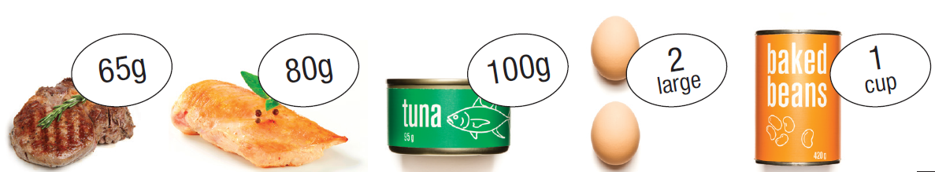
Recommendations:
Meat and Alternatives
Serves per day
 | 19-50 years | 51-70 years | 70+ years
Men | 3 | 2 ½ | 2 ½
Women | 2 ½ | 2 | 2
1 serve is:
Notes:
This is how much we want to have of these foods. For males between 19-50 we would want 3 serves or 2 ½ serves for women of the same age.
1 serve is 65g of red meat. Can anyone show or tell me how much 65g is? The size of the palm of your hand, this may depend on the size of your hands. Generally a thin slice.
And fish is a thin palm of your entire hand.
Some other examples of 1 serve are 80g of chicken, 100g of fish, 2 large eggs or 1 cup of baked beans.
So just to refresh, how much is a serve of red meat or a steak??
Answer: a thin palm of you hand (65g)

Slide 15
Extra Foods
Special occasion foods
  chocolate, cake, lollies, biscuits, soft drink.
Provide energy but little or no other nutrients
Only sometimes and in small amounts
Notes:
Here we have extra foods.
What are extra foods?
Answer: Chips, burger, sausages, cream, sweet biscuits, alcohol.
We call these foods extra foods because although we know that are very tasty they do not provide us with any nutrients like the core food groups that we have been talking about.
We want to have these less often and when we do have them to have them in small amounts.

Slide 16
What does this mean for your Community Kitchen?
Notes:
Conclusion
Refer to healthy eating checklist
Great, we made it through all of the 5 core food groups. So what does this mean for your CKs? We want to try and prepare, cook and eat most of the food that we get from these 5 core food groups. And less from these extra foods outside the plate.
Belinda will talk to you a little later about oils and cooking.

Slide 17
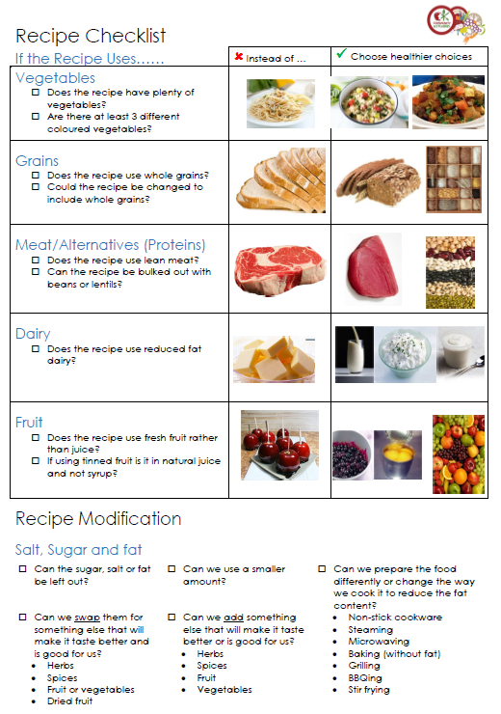
Recipe Checklist
Notes:
To summarise what we have talked about and learnt:
We have 5 core food groups that we want to eat most of the food from.
When you are looking at choosing recipes we want to have lots of vegetables, at least 3 coloured vegetables.
If the recipe has grains in it can we choose whole grains such as brown rice or wholemeal flour.
Choosing lean cut of meat. You can also trim the visible fat from the meat and remove the skin from chicken. Also remembering that you legumes fall under this category and adding them to meals for example in a casserole can be great and nutritious.
When using dairy foods in recipes remember to choose the low fat options.
Fruit, using fruit in deserts or salads can be delicious so just remembering to use fresh fruit, or fruit in it’s natural juices.

Slide 18
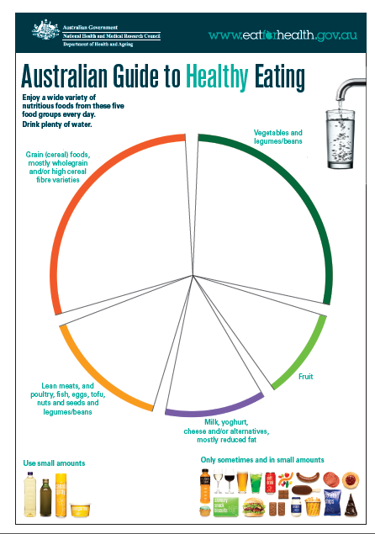
Activity!
Match the food to the right food group.
  Tinned fruit
  Full cream milk
  Mashed potato
  Ham
  Ice cream
  Frozen Vegetables
  White rice
Notes:
What would be a better option for each food?
Where do they fit into the Australian Guide to Healthy Eating
Fruit juice – fruit (1/4 cup)
Tinned fruit - fruit
Full cream milk – Dairy: want to choose low fat
Mashed potato - ??? What is in it? Potato, herbs and milk. If you add high fat dairy i.e. butter, cream. Then it can become an “extra food”.
Ham - discretionary choice.
Ice cream – discretionary choice.
Frozen Vegetables - vegetables
Write rice – Grains: want to choose wholegrain

Slide 19
So what should a typical lunch or dinner look like?
Notes:
We know what a recipe should look like. How much should we have?

Slide 20
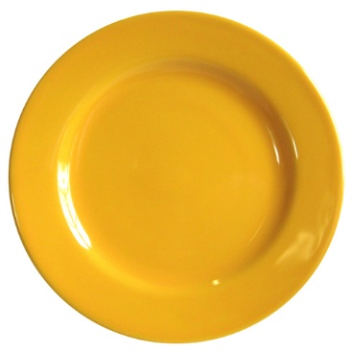
Imagine you are having
Meat
Broccoli, carrots and beans
Rice
For dinner tonight
Draw onto the plate how much you would have of each.
Notes:
Mixed dishes
https://sophisticup.com/zencart/images/Buttercup%20Rimmed%20Dinner%20Plate%207721276715.jpg

Slide 21
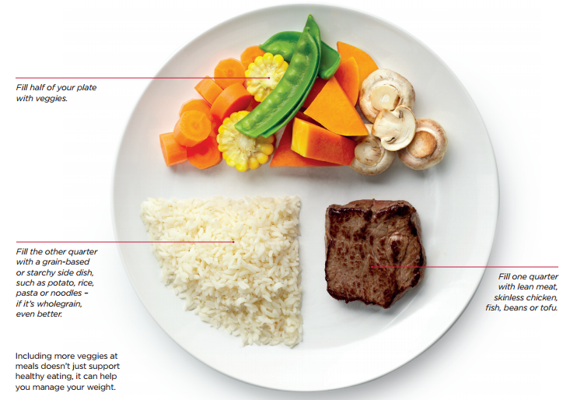
Does your plate look like this?
Notes:
http://www.shapeup.gov.au/downloads/Portions-Shape-Up-With-Smaller-Portions.pdf

Slide 22
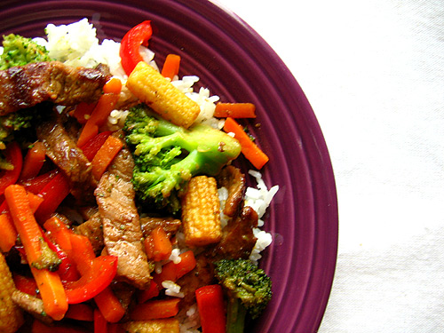
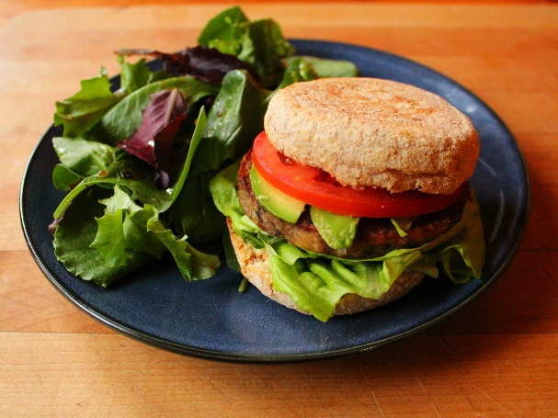
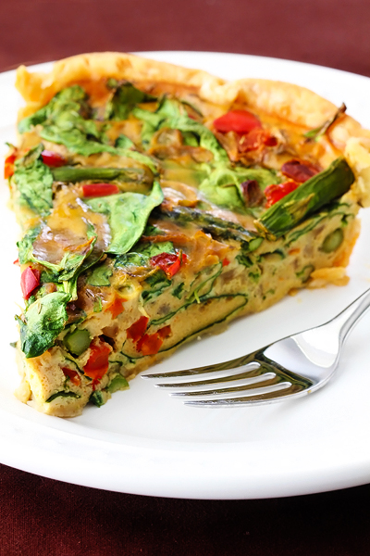
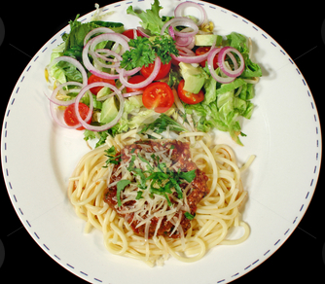
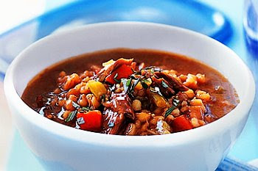
Mixed Dishes and The Healthy Plate
Notes:
http://ilv-pullzone1.ilovevegan.netdna-cdn.com/wp-content/uploads/2014/01/veggie-burger-with-tomato-and-avocado.jpg
http://www.gimmesomeoven.com/wp-content/uploads/2012/03/dairy-free-quiche-slice.jpg
http://watermarked.cutcaster.com/cutcaster-photo-100209014-Spaghetti-Bolognese-And-Salad.jpg
https://4.bp.blogspot.com/_SXI6Wkrbyic/TTstSmxgGkI/AAAAAAAAAJQ/Fw4T0UvsBAs/s400/beef-barley-soup-recipe.jpg

Slide 23

Recipe Modification
Sometimes the recipes that we want to make don’t have the healthiest ingredients in them.
What can we do?
Lets Modify Them!
Notes:
Sometimes the recipes that we want to make don’t have the healthiest ingredients in them.
What can we do?
Lets Modify The Recipe
https://assets0.learni.st/board_image/1003660/image/w744h744_17002-recipe-modification.jpg

Slide 24
Ingredients to Look For in Recipes
Fatty foods
Butter
Animal fat (dripping)
Cheese
Cream
Sour cream
Coconut oil, cream, milk
Sugary foods
Table sugar
Brown sugar
Caster sugar
Syrups
Honey
Malt
Salty foods
Table salt
Canned and jarred food
Processed meat
Cured/ pickled food
Take away foods
The “Only sometimes and in small amounts” foods
Notes:
When we are looking at a recipe the main things to focus on are fatty, sugary or salty foods.
By changing recipes so that they have less of these things we are helping our weight, heart, blood sugar and blood pressure
Fatty foods that we should have less of are things like
high fat dairy (butter, cheese, cream)
And animal fat
Sugary foods include to have only sometimes and in small amounts might be
Any types of sugar
Syrups
Honey
Malt
Salty Food such as
Adding salt during cooking or at the table
Anything that comes in a can or jar can be high in salt
Processed meats are cured with salt. That is why ham is considered a “extra food”.
Takeaway foods often contain a lot of salt.
Can you think of others?

Slide 25
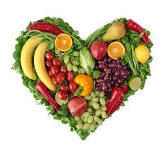

Fats: Good Fats are Healthy For Your Heart
Monounsaturated Fat
↓ Bad cholesterol
↑ Good cholesterol
Example
  Olive oil
  Canola oil
  Avocado oil
  Nut oils (peanut, hazelnut, cashew and almond)
Polyunsaturated Fat
↓ Bad cholesterol
Example
  Corn oil
  Safflower oil
  Sunflower oil
  Soya bean oil
  Most margarines
  Oily fish
  Nut oils (walnut and brazil)
Use small amounts
Notes:
Not all fats are the same. Some are good for our heart and others increase our risk of developing heart disease.
Regardless of the type we have we need to be only having small amounts everyday.
There are 2 types of good fat.
The first one is monosaturated fat
This works in 2 ways by reducing bad cholesterol and increasing good cholesterol
Examples of monosaturated fat are:
Olive oil
Canola oil
Avocado oil
Nuts oil
Seed oils
The Second one is Polyunsaturated fat
Which works by decreasing bad cholesterol
Examples of polyunsaturated are
Corn oil
Safflower oil
Sunflower oil
Soya bean oil
Most margarines
Oily fish
Nut oils
http://t1.gstatic.com/images?q=tbn:ANd9GcQ7ibRSdwYaQMiPyrkU9Ph8E7fOddKEwyk6xzyI0Oz-UZ-H7-ZdQg
http://www.htv.com.pk/images/articles/life/good-oils-vs-bad-oils-make-the-right-choice.jpg
http://www.betterhealth.vic.gov.au/bhcv2/bhcarticles.nsf/pages/fats_and_oils?open

Slide 26

Fats: Bad Fats are Unhealthy For Your Heart
Saturated Fat
↑ Bad cholesterol
Increases your risk of heart attack and stroke
Examples:
Full fat dairy foods
Butter
Cream
Lard
Dripping
Fatty meat and poultry
Coconut oil, cream and milk
Notes:
The third type of fat is saturated fat
This fat increases the bad cholesterol in our blood and because of this, increases our risk of heart disease and stroke.
Examples of saturated fat are
Full fat dairy foods
Butter
Cream
Lard
Dripping
Fatty meat and poultry
And coconut oil, cream and milk
This is why the Australian Dietary Guidelines recommends to have low fat dairy and lean meats.
http://www.biggone.com/wp-content/uploads/2013/07/Ten-tips-for-a-healthy-heart1.jpg

Slide 27
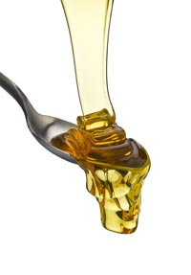
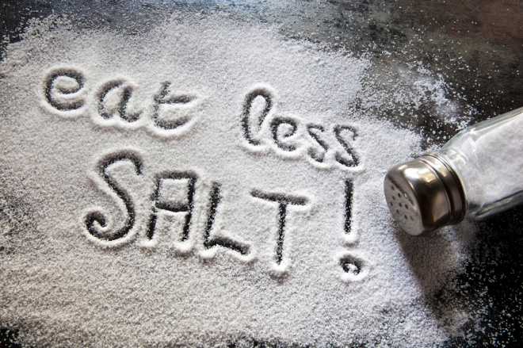
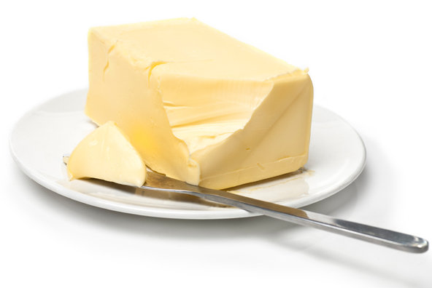
Modifying a Recipe with Fat, Sugar or Salt
Can the fat, sugar or salt be removed from the recipe?
    Does the recipe need it?
    Are we adding it out of habit?
Can we reduce the amount we use?
    Use a spray oil
Notes:
Can we take the fat out?
Does recipe really need it? (sometimes we add fat out of habit)
Can you think of a recipe that you use that probably doesn’t need the fat added? (sandwich)
Can we use less fat?
Using a spray oil instead of liquid
Or putting less in the pan

Slide 28
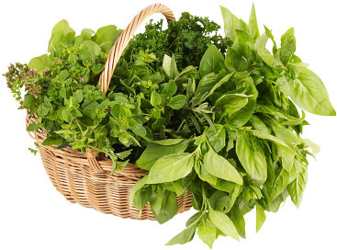

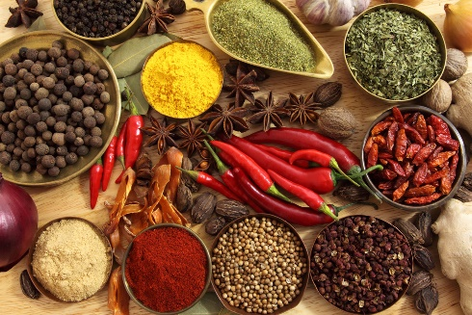
Modifying a Recipe with Fat, Sugar or Salt
Can we replace it for something better for us?
    Herbs/ spices
  Fat
    Better fat (monounsaturated or polyunsaturated)
    Low fat/Fat free
  Sugar
    Fresh fruit, tinned fruit in natural juices or dried fried
  Salt
    Citrus juices
    Vinegar
Notes:
Can swap it for something better for us?
Can we choose a better fat? (monounsaturated or polyunsaturated) like olive oil
Herbs/ spices
Low fat or Fat free product (cheese or yoghurt?)
Lean meats or trim fat, remove skin
Can we add something extra to make it better for us?
Vegetables
If it was a dessert we could add in some fruit
Fiber
Can we prepare or cook it in a different way that doesn’t need a lot of fat to be used?
Non stick cookware
Stir frying
Steaming
BBQing
Microwaving
Baking (without fat)
Grilling
http://www.gourmetkoshercooking.com/wp-content/uploads/2014/05/Fresh_herbs.jpg

Slide 29
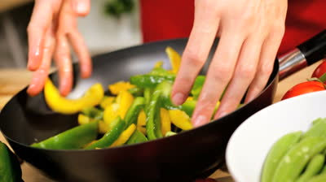
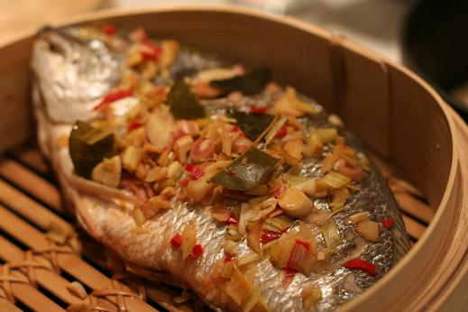
Modifying a Recipe with Fat, Sugar or Salt
Can we add something extra to make it better for us?
    Vegetables
    Fruit
    Fibre
Can we prepare or cook it differently to reduce the fat?
  Non stick cookware
  Stir frying
  Steaming
  BBQing
  Microwaving
  Grilling
  Baking (without fat)
Notes:
http://dinnerdiary.org/wp-content/steamed_sea_bream.JPG

Slide 30
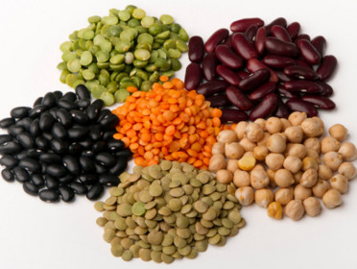
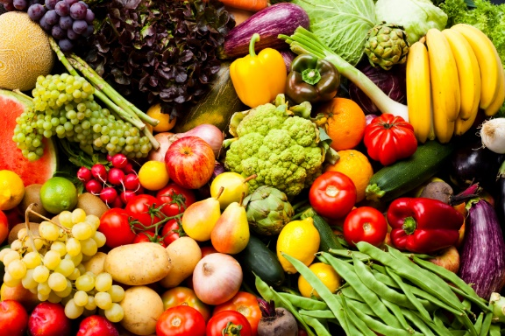

Swap or Add in Fibre
Beans/ lentils
Vegetables
Fruit
Whole grains
Work by
↑ Vitamins and Minerals
Healthy bowel
Helps with maintaining healthy weight, diabetes and heart disease
Notes:
We can help to make recipes better for us by adding in extra in extra
Beans/ lentils
Vegetables
Fruit
Whole grains
The reason this is help is because it
↑ Vitamins and Minerals
Healthy bowel
Helps with maintaining healthy weight, diabetes and heart disease
http://cdn.vogue.com.au/
http://www.enjoyhighfibrefoods.com/wp-content/uploads/2013/05/foodshighinfibre.jpgmedia/articles/2/4/9/0/24985-1_n.jpg?173537
http://images.idiva.com/media/content/2014/May/fibrefood111.jpg

Slide 31
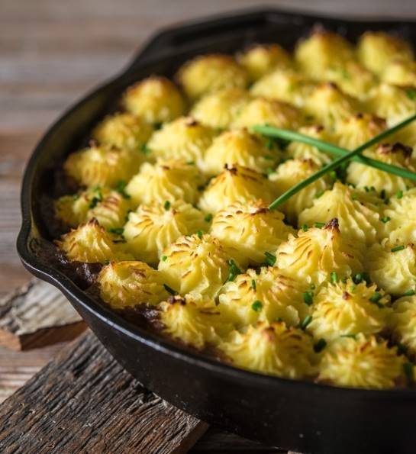
Recipe Activity:
How can we improve this recipe?
Shepherds' pie (serves 4):
  500 g minced beef
  1 large onion, diced
  1 tablespoons oil
  500mL of beef stock
  3 tablespoons tomato paste
  400 g tin peeled tomatoes
  1 teaspoon oregano
  Salt and pepper to taste
  800g potato, peeled, chopped
  40g butter
  100g cheese
  125mL full cream milk
Notes:
Explain activity

Slide 32

Recipe Activity
Reduce the amount of meat to 250 g and add a can of well-drained butter or kidney beans
Replace with premium (lower fat) minced beef
Shepherds' pie (serves 4):
  500 g minced beef
  1 large onion, diced
  1 tablespoons oil
  500mL of beef stock
  3 tablespoons tomato paste
  400 g tin peeled tomatoes
  1 teaspoon oregano
  Salt and pepper to taste
  800g potato, peeled, chopped
  40g butter
  100g cheese
  125mL full cream milk
Reduce amount by ½ or replace with a canola spray oil
Use ‘no added salt’ or ‘reduced salt’ products
Replace salt with freshly ground black pepper, plenty of herbs – oregano, basil, parsley
Add finely chopped/grated vegetables such as zucchinis, sweet potato, carrots, corn
Reduce the amount of butter
Reduce the amount of cheese (could use less of an aged cheese like parmesan)
Replace the full cream milk for a ‘low fat’ variety

Slide 33
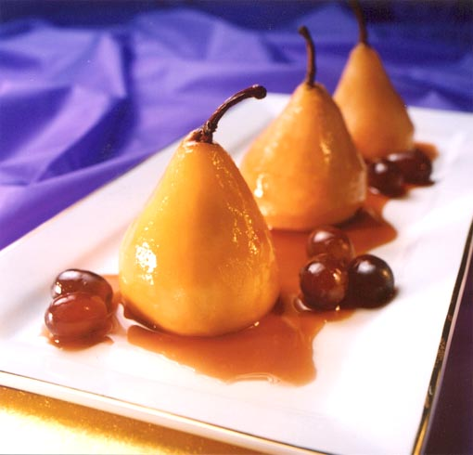
What about desserts?
Where do desserts fit into the Australian Guide to Healthy Eating?
The “Only sometimes and in small amounts” foods
Recipe modification ideas?
Use fresh or diet fruit to sweeten
Swap white flour for wholemeal flour
Swap butter for margarine
Swap sugar for spices, cinnamon or vanilla
Reduce the amount of cream, ice cream or custard.
Notes:
So where do desserts fit into the Australian Dietary Guidelines?
The “Only sometimes and in small amounts” foods
With dessert we need to think about how big of a portion we are having
Some tips for making desserts healthier are
Use fresh or diet fruit to sweeten
Swap white flour for wholemeal flour
Swap butter for margarine
Swap sugar for spices, cinnamon or vanilla
Reduce the amount of cream, ice cream or custard.
We can try to make these healthier however we still shouldn’t be having them too often

Slide 34
Finding Healthy Recipes Online

Slide 35
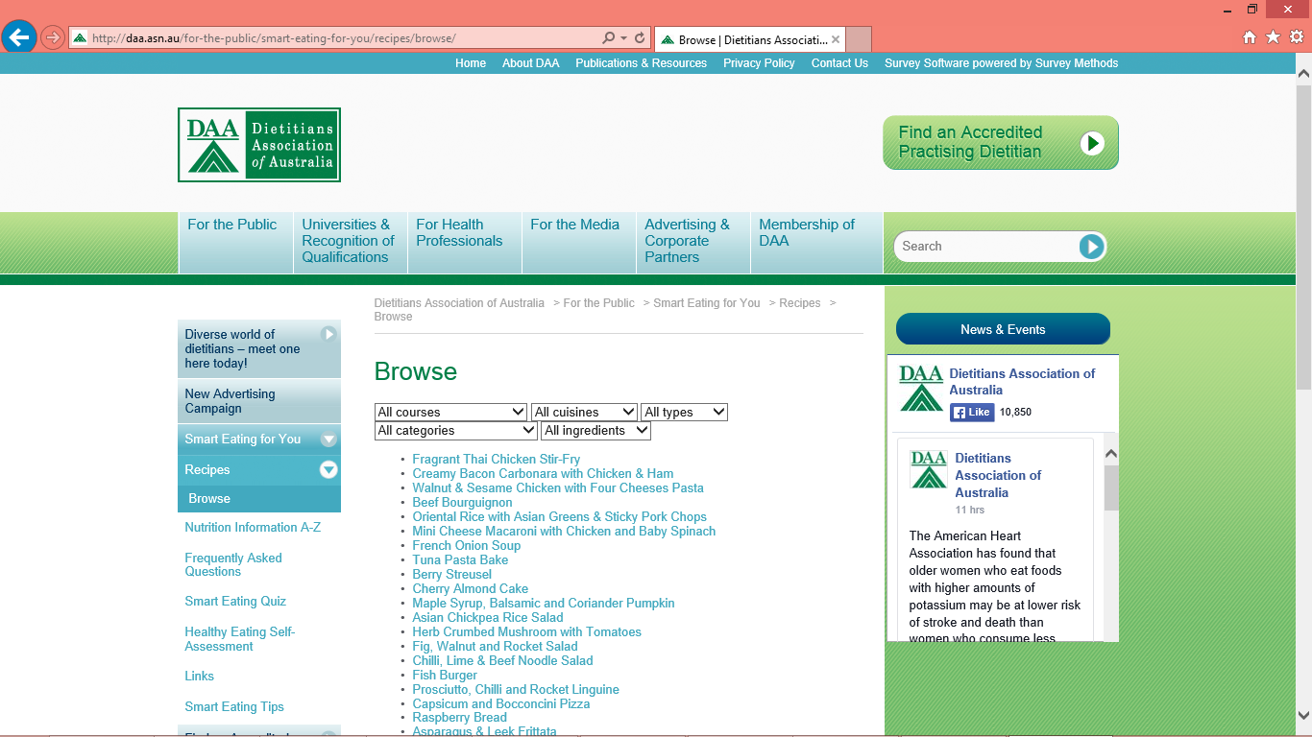
Dietetics Association of Australia (DAA)
http://daa.asn.au/for-the-public/smart-eating-for-you/recipes/browse/

Slide 36
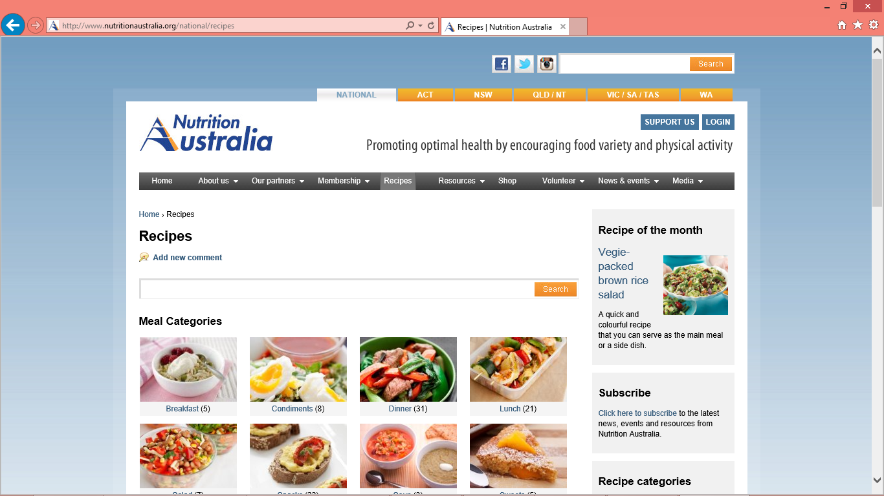
Nutrition Australia
http://www.nutritionaustralia.org/national/recipes

Slide 37
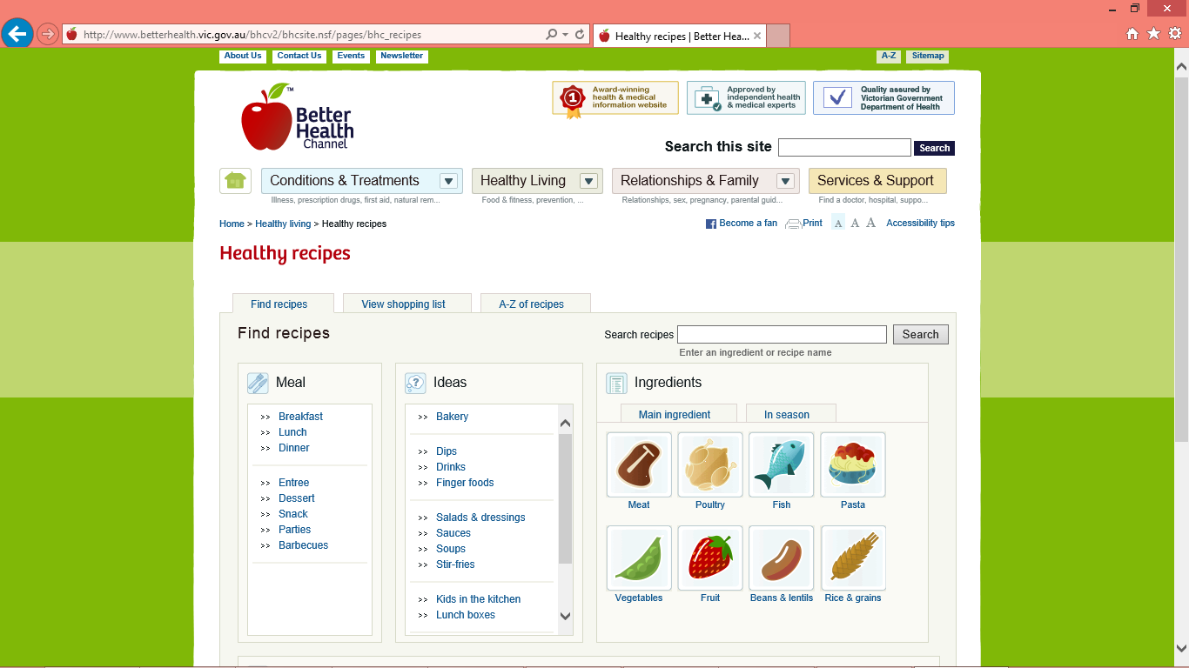
Better Health Channel Recipes
http://www.betterhealth.vic.gov.au/bhcv2/bhcsite.nsf/pages/bhc_recipes

Slide 38
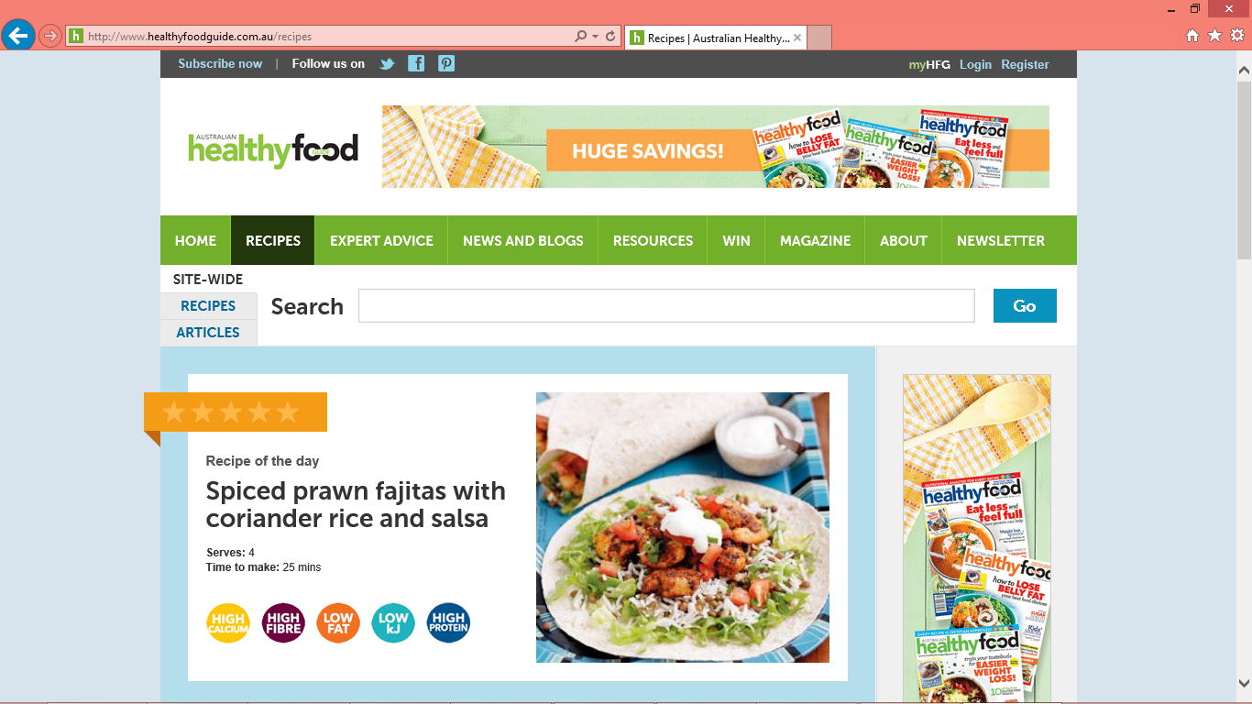
The Healthy Food Guide
http://www.healthyfoodguide.com.au/recipes

Slide 39

What have we learnt?
Importance of food
Food groups
Modifying a recipe
What a meal should look like
Notes:
We are now at the end of our nutrition presentation
What are some of the things we talked about?
Importance of food
Food groups
Modifying a recipe
What a meal should look like
https://2.bp.blogspot.com/-RhrEd4Mfiu4/UUjqsjPahSI/AAAAAAAAEzU/8v4huk37cBk/s1600/Thank+You+LCF.jpg

Slide 40


Please complete this survey to record your completion of this training and provide your feedback on the Nutrition training module.
https://redcap.barwonhealth.org.au/redcap/surveys/?s=H9A8NDT9TF
For further information:
Please contact Barwon Health Community Kitchen Coordinator:
healthycommunities@barwonhealth.org.au

Slide 41
For further information
Recipe Modification
http://www.heartfoundation.org.au/SiteCollectionDocuments/Recipe-Guidelines.pdf
Recipe Checklist (alternatives and cooking methods)
http://www.bakeridi.edu.au/Assets/Files/Making%20Healthy%20Meals%20(2012).pdf
www.communitykitchens.org.au

