Slide 1

Budgeting in the Kitchen

Slide 2
Today we are talking about:
Managing your food costs
while
Maintaining healthy eating

Slide 3
What stops you keeping food costs down?
  Impulse buying
  Forgetting items
  Buying what you already have
  Taking a long time to shop
  Making poor food choices
  Missing out on specials

Slide 4
Budgeting – 1. Menu Planning

Slide 5
Menu Planning :
saves money, time and effort
you can balance your food intake
becomes your shopping list

Slide 6
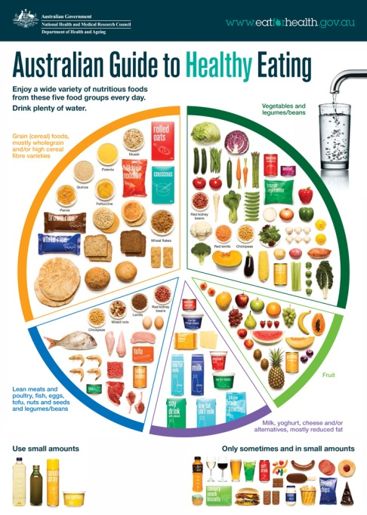
Components of a healthy meal
A balanced main meal should contain:
  grains; and
  vegetables: and
  protein foods
…in the amounts recommended in the
Australian Guide to Healthy Eating.
    Grains (cereals)
    & vegetables
    Protein foods

Slide 7
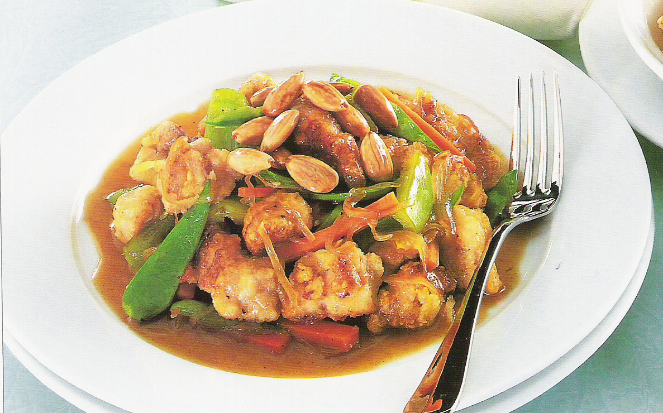
Chicken and vegetable stir fry:
What’s missing?

Slide 8

Eat most = Spend most
Eat moderately = Spend moderately
Eat least = Spend least

Slide 9
How to budget
Another way to think about this is for every $10 you have spent:
        $6 on fruit, vegetables, breads, cereals and grains (Eat Most)
        $3 on lean meats, poultry, fish, eggs, nuts and legumes (Eat Moderately)
        Less than $1 on all ‘sometimes’ foods e.g. chocolate, chips, soft drinks. (Eat least and on rare occasions in small amounts)

Slide 10
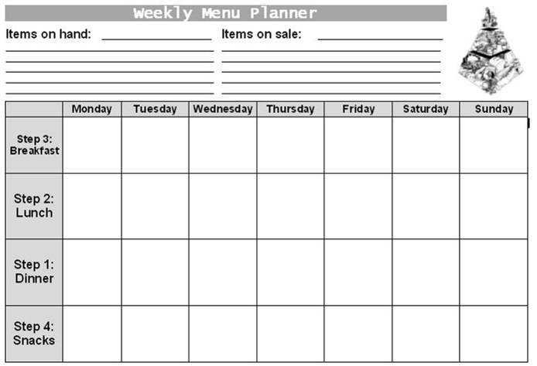
Menu Planner
“Items on hand” includes leftovers, items close to their use-by-date and anything else in your fridge, freezer or pantry that could be used in a meal.
“Items on sale” – check out supermarket catalogues for specials and list them here.

Slide 11
Tips for planning a menu
Look at specials advertised
Use seasonal produce, it is often cheaper
Look at what you have already
Use raw ingredients rather than prepared foods
Consider growing produce
Make a shopping list

Slide 12
Using a shopping list
less likely to forget an item or buy extra
include fruit, vegetables and grains
keep a list in the kitchen that you can add to

Slide 13
Vegetables
Make sure the recipes you are using contain at least 3 vegetables.
Remember that vegetables can be fresh, frozen or canned – whatever is cheapest or that you have on hand.
It’s a good idea to have frozen mixed vegetables in the freezer as a quick alternative.

Slide 14
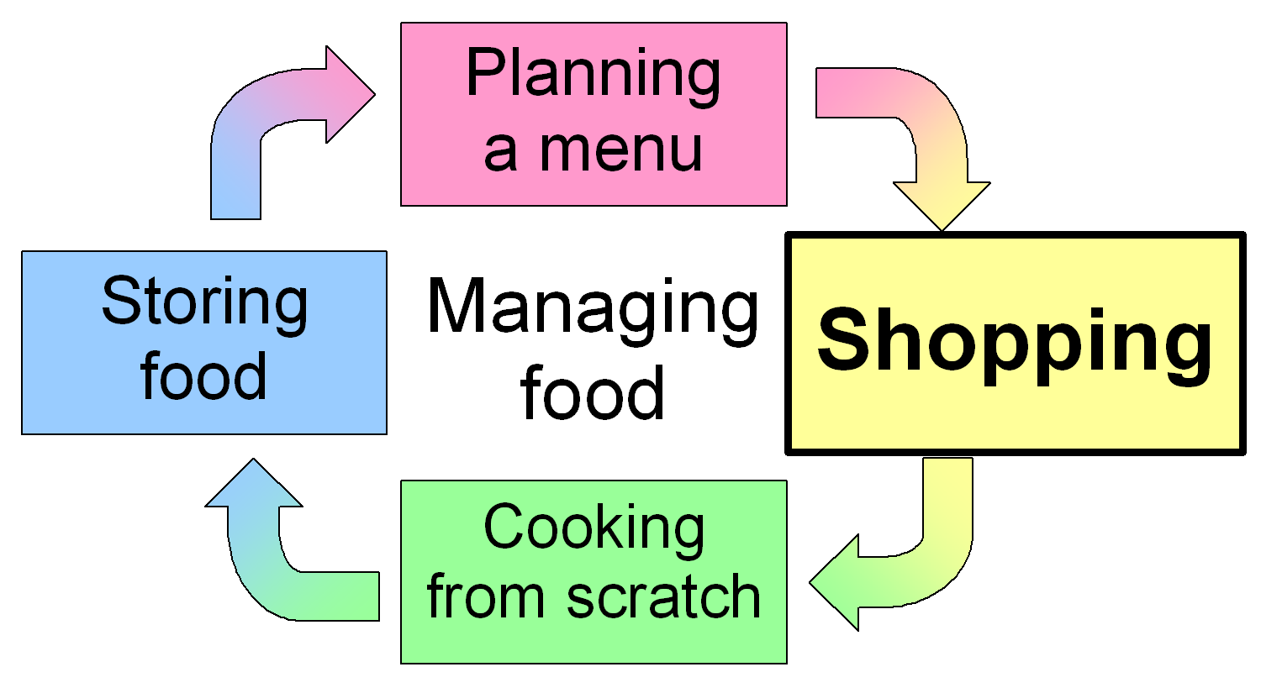
Budgeting - 2. Shopping

Slide 15
Apples - $4.50/kg
Vegetables - $3-4.50/kg
Bread - $3.30/kg
Oats - $2.99/kg
Rice - $1.63/kg
Meat - $9-17/kg
Eggs - $4.65/kg
Milk - $1.00/kg
Chocolate block - $22.90/kg
Muesli bar - $22.00/kg
Potato chips - $24.60/kg

Slide 16
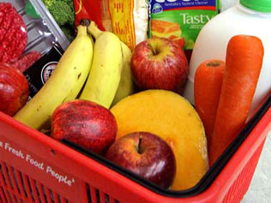
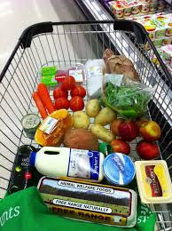
Budgeting Myth or Fact
People who shop daily spend $60 per person per week more than those who shop weekly or fortnightly
Fact

Slide 17
Why shop once a week?
Forces you to plan
and be more organised
Saves time
Saves money
A general rule:
Items that keep longer should be bought less often
Items that go off more quickly (e.g. fruit and vegetables) should be bought in smaller quantities and more often

Slide 18
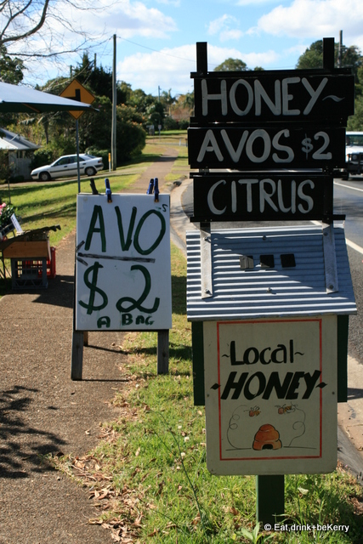
Budgeting Myth or Fact
Always shop around for the cheapest supermarket
? Myth or Fact

Slide 19
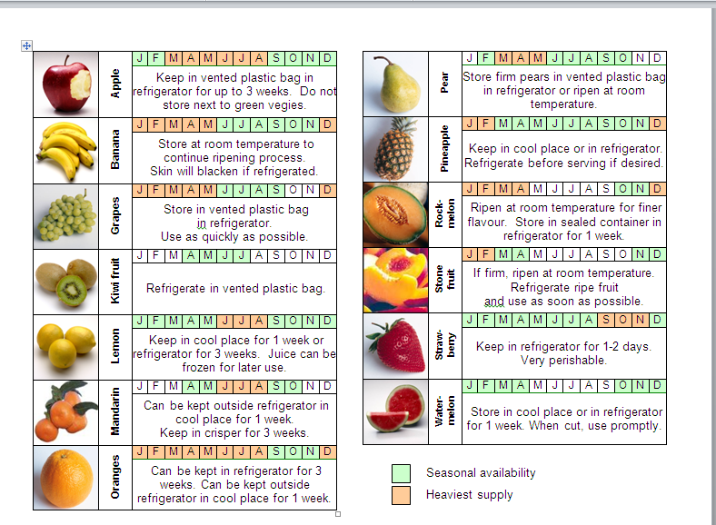
Budgeting Myth or Fact
We can buy fresh produce these days all year round at low cost prices
Myth

Slide 20
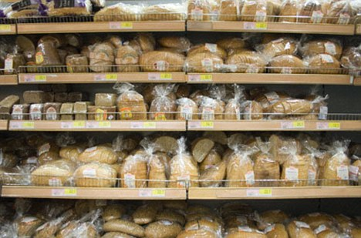
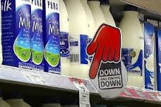
Budgeting Myth or Fact
You can easily make a quick trip into the supermarket to get a few basic items?
Myth

Slide 21
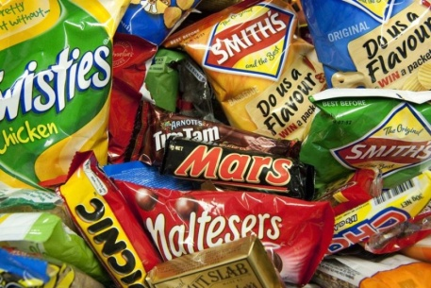
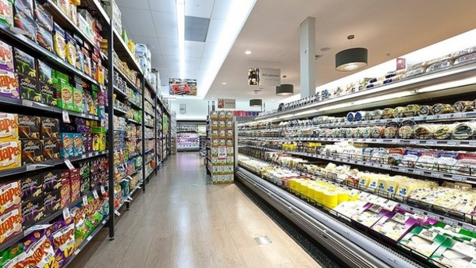
Budgeting Myth or Fact
You should not go shopping when you are hungry or when you have time to browse
Fact

Slide 22
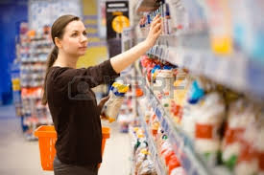
Budgeting Myth or Fact
Always choose supermarket items that are on shelves that are at eye level/easier to reach
Myth

Slide 23
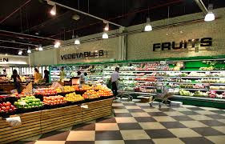
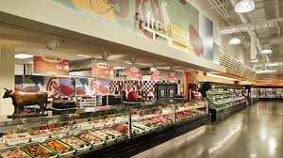
Budgeting Myth or Fact
Always shop around the outside walls of the supermarket
Fact

Slide 24
Value for Money
The least processed foods are the cheapest.
  red kidney beans, canned vs. dried
    canned prepared (100 g) $0.48
    dried prepared (100 g) $0.24
  potato vs. potato chips
    Potato (1 kg) $2.00
    Crisps (1 kg) $24.60
  apples vs. muesli bars
    Apples (1 kg) $4.50
    Muesli bars (1 kg) $22.00

Slide 25
At the supermarket
First shop the perimeter where fresh food lives: fruit, vegies, meats and dairy
Never shop on an empty stomach: approximately 60-70% of purchases are unplanned
Stick to list to reduce impulse buying
Be aware that eye level displays are where big profit brands lay so try reaching and bending down to finding cheaper brands.
Don’t assume best bargains are at the end of aisles

Slide 26
At the supermarket
Use a hand basket instead of a trolley to reduce over purchasing
Choose weight of food you require for your meal plan and only buy what you need
Identify frozen versus fresh versus tin: Buy in season
Prepare foods e.g. chop and grate
Watch the queue at the checkout as it can increase your likelihood to make ‘treat purchases’ so try and find ‘junk-free’ checkouts

Slide 27
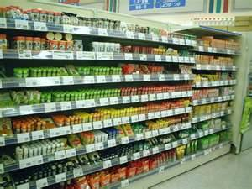
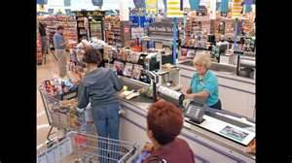
Out-smarting the super-marketing
“In your face”
“Sensory delights”

Slide 28
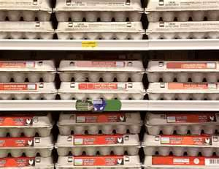
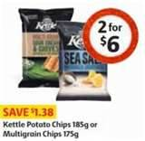
Out-smarting the super-marketing
“Where are the eggs?”
“Sacrificial lamb”

Slide 29
Out-smarting the super-marketing
“This goes with that”
“The trouble with trolleys”

Slide 30
Out-smarting the super-marketing
“Super specials?”
“Checkout tempters”

Slide 31
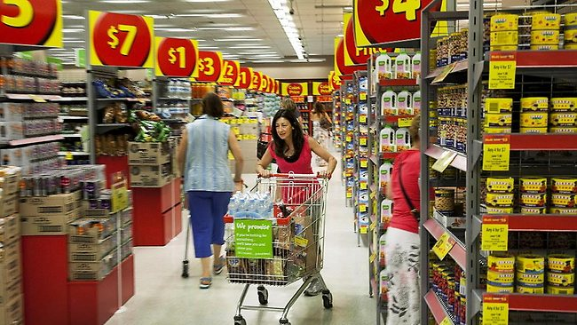
Out-smarting the super-marketing
“In-store displays”
“Promotions”
Limit 3 per customer

Slide 32


Out-smarting the super-marketing
“Buy one get one free”
“In-store music”

Slide 33
Budgeting - 3. Cooking from scratch

Slide 34
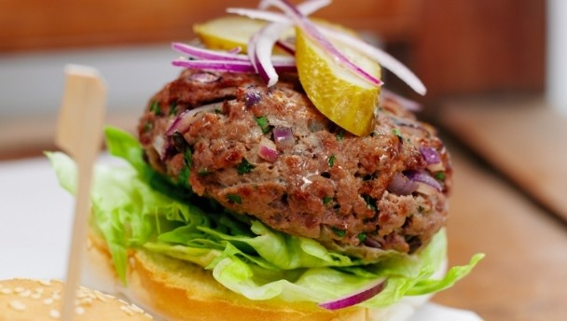
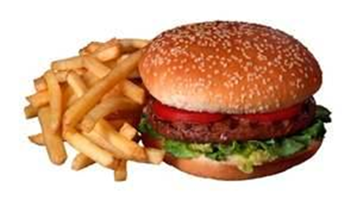

Budgeting Myth or Fact
Take away foods are cheaper and more filling than home cooked meals
Myth

Slide 35
Cooking at home
Cheaper to cook with raw ingredients rather than buying ready-made
Serve meals with more vegetables or grains and cereals
Basic take-away foods can be made at home at a much cheaper price.

Slide 36
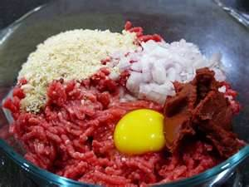
Cooking at home
Make your own homemade hamburgers, pizzas and souvlakis
Use less meat by using alternative sources of protein such as tin salmon or tin tuna, eggs, or lentils, tofu, chickpeas and kidney beans.

Slide 37
Modifying recipes
You are making a Bolognese sauce for pasta. The recipe says to use 1 kg of minced beef ($12.00). What could you do to make this meal cheaper?
  Replace half the beef with cooked lentils or red kidney beans (saves $4.63)
  Add diced and cooked carrot and celery to replace some of the meat (saves $5.70)
  If the recipe calls for red wine, use beef stock/tomato juice/water instead

Slide 38
Modifying recipes
You are making a stir fry for 4 people. The recipe says to use 600g red meat. What could you do to make this meal cheaper?
  Cut down to 260g meat (65g per person as recommended) but serve with more vegetables or carbohydrates to provide more bulk (saves approximately $2.00)
  Replace some or all of the meat with chicken (saves $3.60) or tofu (saves $5.73)
  Replace some or all of the meat with chickpeas or red kidney beans (saves approx. $13.00)

Slide 39
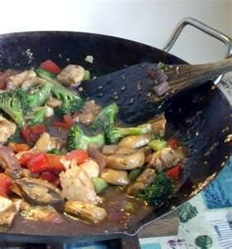
Excuses, excuses!
I can’t cook!
  It’s not about gourmet perfection it’s about simple food. Anybody can cook using a few basic skills… especially you!
  Choose simple recipes with few ingredients and move on to more complex recipes as you gain confidence.

Slide 40
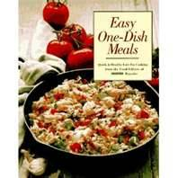
Excuses, excuses!
It takes too long to prepare and I don’t have the time.
  A healthy meal with fresh, simple ingredients can be prepared in around 30 minutes. When you want a quick meal, steer away from complicated recipes and instead make pasta, stir fries or one-pot dishes.

Slide 41
Excuses, excuses!
I hate shopping.
  If you are one of these people perhaps the best thing you can do is be as organised as possible to limit the time you need to spend in the shop. This includes menu planning, writing a shopping list and knowing your supermarket layout

Slide 42
Excuses, excuses!
I can’t be bothered to cook for one.
  If you’re short on time during the week why not have a weekend cookfest and freeze meals for use on weeknights.
  Invite a friend over and take it in turns to cook for each other.

Slide 43
Excuses, excuses!
It’s too difficult to get to the shop.
  It might be worth enquiring about home delivery in your area. Some smaller businesses (e.g. greengrocers) offer a free delivery service.
  Try to arrange to shop once a week with a friend who has a car.

Slide 44
Excuses, excuses!
My family all like different meals – I can’t please them all!
  Including your family in the planning process can assist with this problem. E.g. If they only like convenience/fast food, try to make healthier versions at home. You may want to make sure each person gets their favourite healthy choice at least once a week. Try to introduce them to new foods as often as possible.

Slide 45
Excuses, excuses!
I don’t have the right ingredients to make anything.
  If you keep your freezer, fridge and pantry well-stocked with the basic items, you will always have a quick meal available. The next module will cover what these basic items are and how to store them.

Slide 46
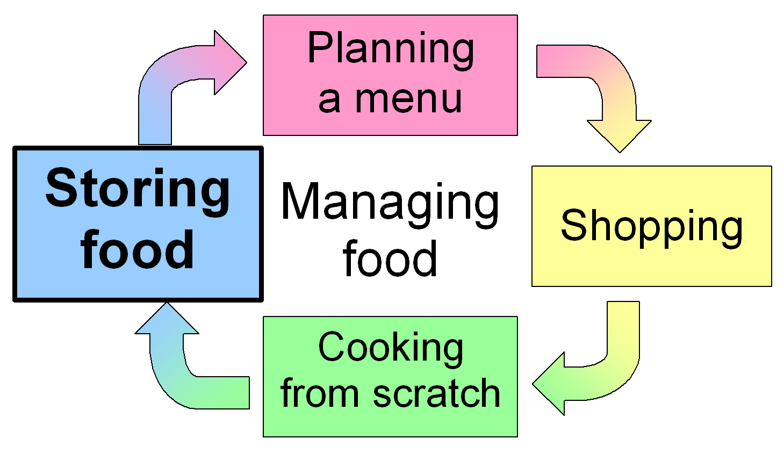
Budgeting - 4. Storing Food

Slide 47
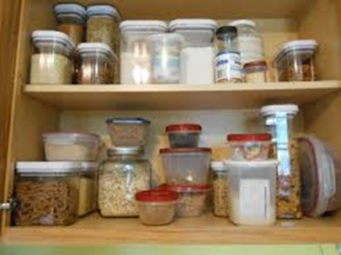
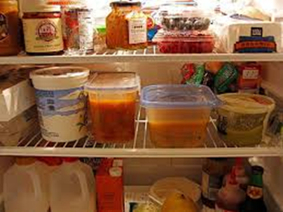
Storing food
Storing Food
What are some good items to keep in your pantry, fridge and freezer?

Slide 48
Stocking up
Freezer
Frozen vegetable mix | Bread | Filo pastry
Frozen Peas | Pizza bases
Milk | Margarine/butter | Egg
Cheese | Mayonnaise (low fat) | Plain yogurt
Flour – plain and S.R. | Canned tuna | Olive/canola oil
Cornflour | Canned fruit | Vinegar
Stock powder/cubes | Canned corn | Tomato paste
Onions | Canned tomatoes | Soy sauce
Skim milk powder | Garlic | Chilli powder
Custard powder | Baked beans | Oregano
Sugar – brown and white | Canned evaporated milk | Curry powder
Rice | Oats | Cinnamon
Pasta (and/or noodles) | Breakfast cereal | Nutmeg
Pepper | Dried peas/beans/lentils | Vanilla essence
Fridge
Pantry

Slide 49

Budgeting Myth or Fact
Canned and frozen foods are not as healthy as fresh.
Myth

Slide 50
Storage of bulk buys
Here are some ideas for storage of bulk items:
Large jars of tomato paste can be frozen in small portions using an ice cube tray;
Prepare dried beans in a big batch and then portion out for freezing;
Bulk packs of meat on special can be portioned out and frozen.
To prevent creepy-crawlies in your flour, store it an airtight container in the fridge.

Slide 51
General tips
Store like items near each other so you can clearly see what you have and don’t have and can find things easily.
FIFO stands for “first in first out” – in other words the first item put away should be the first item to come out. This helps to ensure that older items are used before new ones.

Slide 52
More tips
Label items to be frozen with contents and date of purchase/preparation.
Bread becomes stale quickly in the fridge. Store it in a dark, dry cupboard or in the freezer if not for immediate use.
Washing fruit and vegetables before storing reduces preparation time later, and keeps the fridge clean. (Lettuce and other leafy vegies should be dried thoroughly before storing, or they become slimy.)

Slide 54
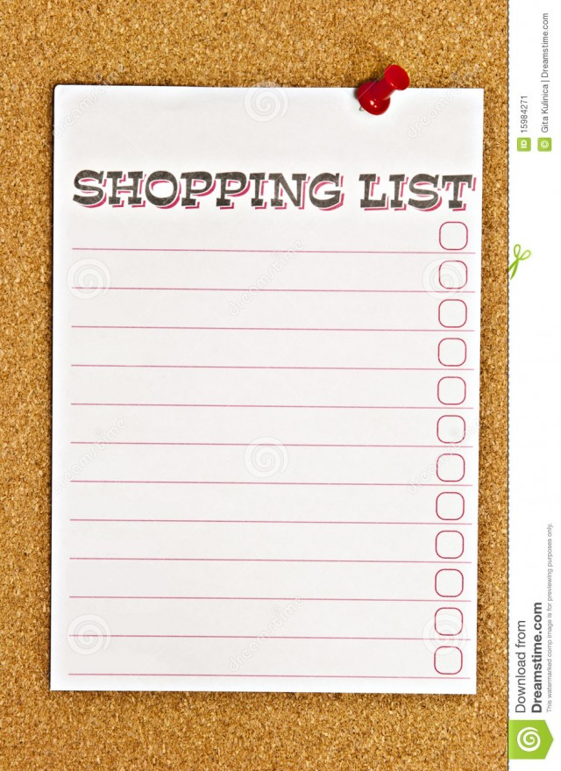
Key Messages
Plan your meals and make a list before you go food shopping
Know your food shop and the best way to shop for healthy foods for you and your family

Slide 55

Please complete this survey to record your completion of this training and provide your feedback on the Budgeting training module.
https://redcap.barwonhealth.org.au/redcap/surveys/?s=W7RRK3XL4D
For further information:
Please contact Barwon Health Community Kitchen Coordinator:
healthycommunities@barwonhealth.org.au

